Slide 1
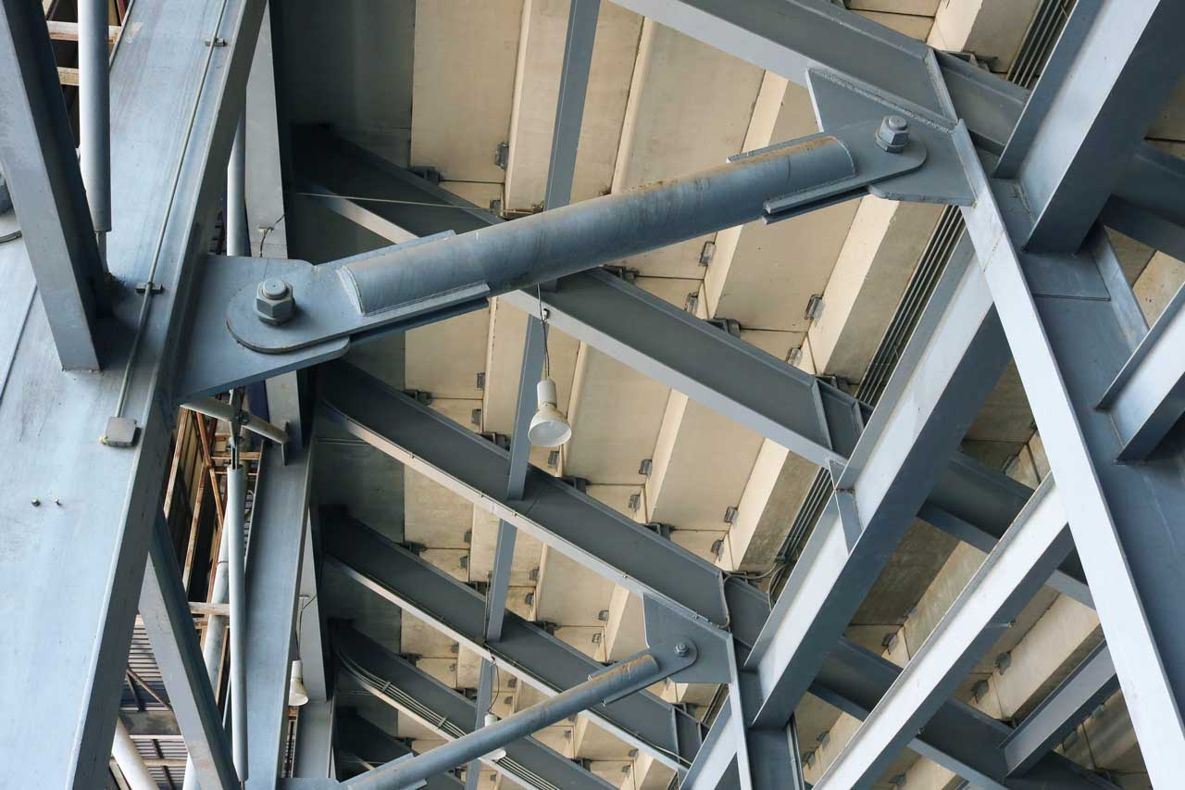
Connection bar

Slide 2
Connection bar

Slide 3
Roller support

Slide 4
Roller support

Slide 5
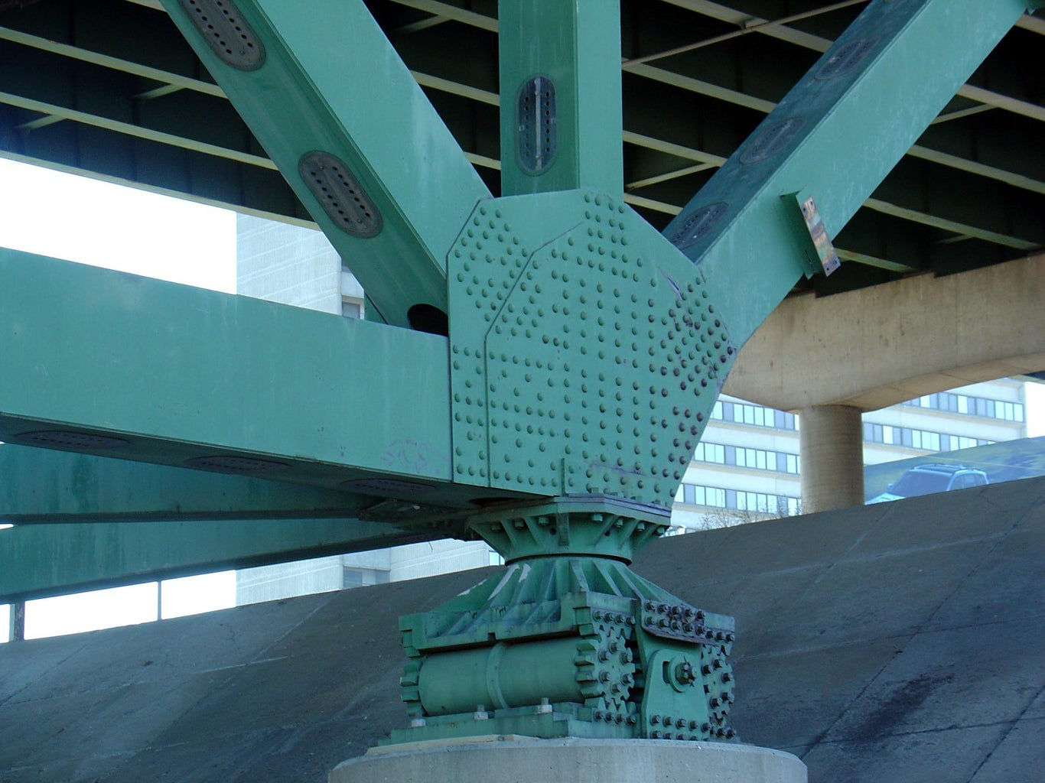
Roller support

Slide 6
Hinge support

Slide 7
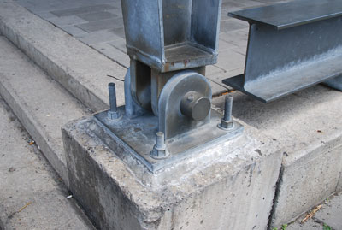
Hinge support

Slide 8
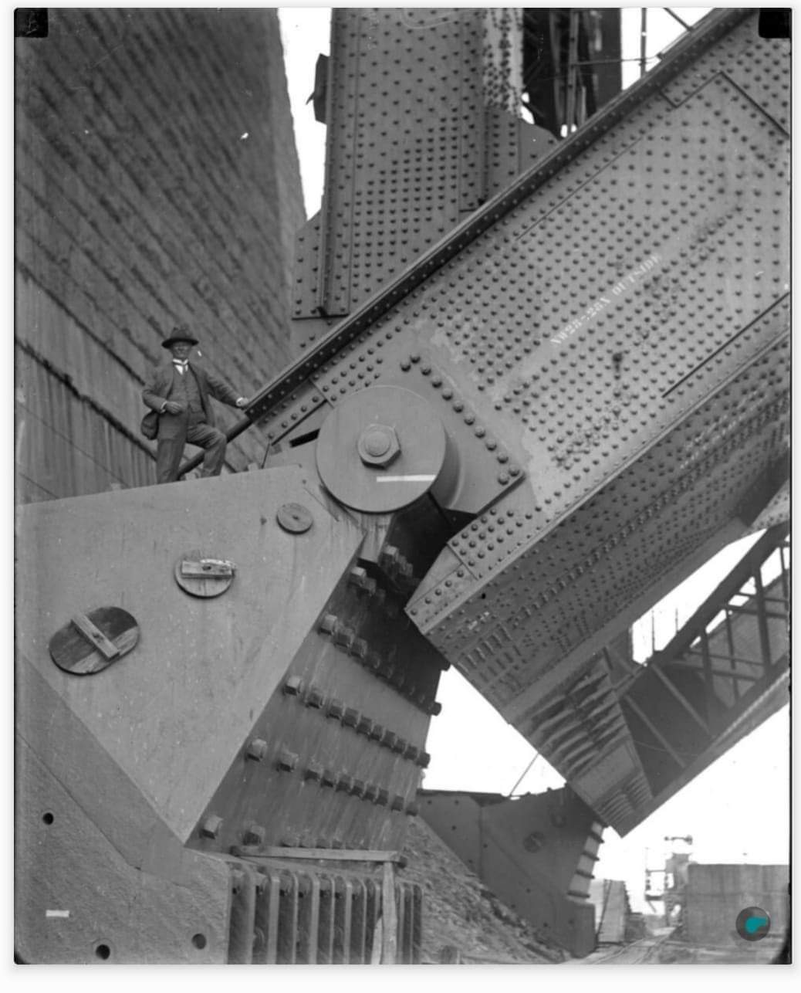
Hinge support

Slide 9
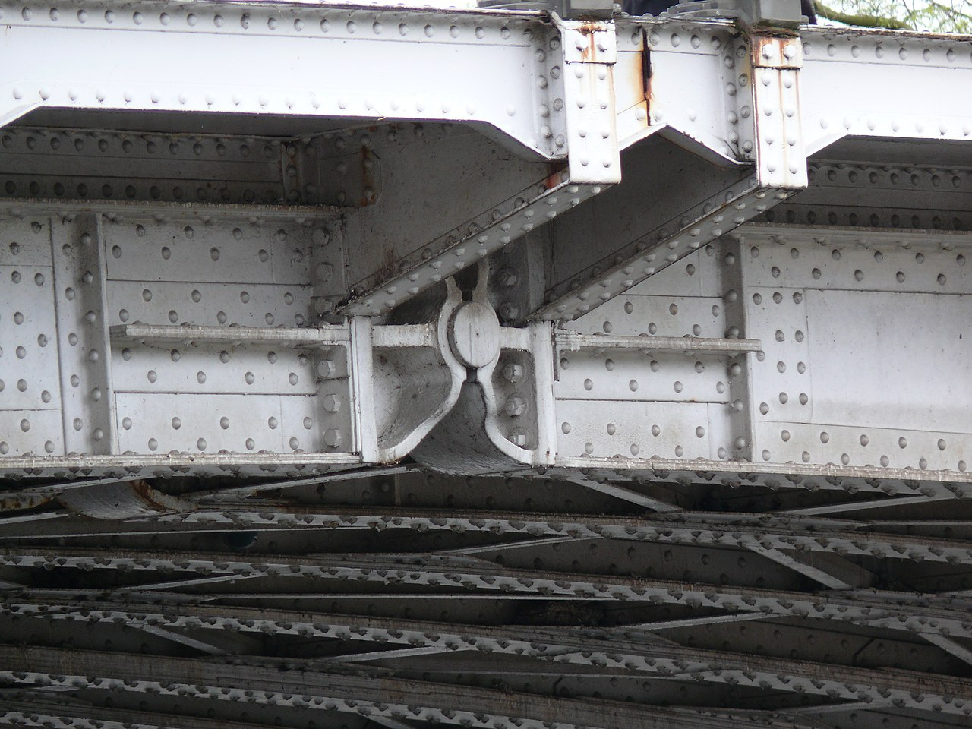
Hinge connection

Slide 10
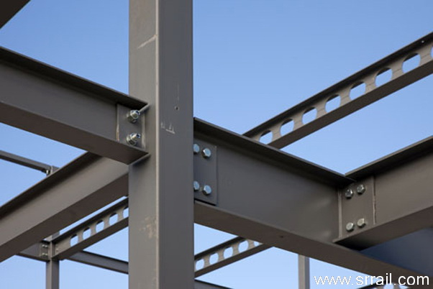
Hinge connection

Slide 11
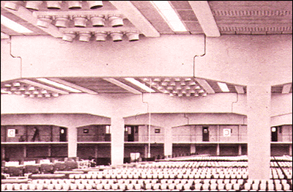
Beam Hinge Connection

Slide 12
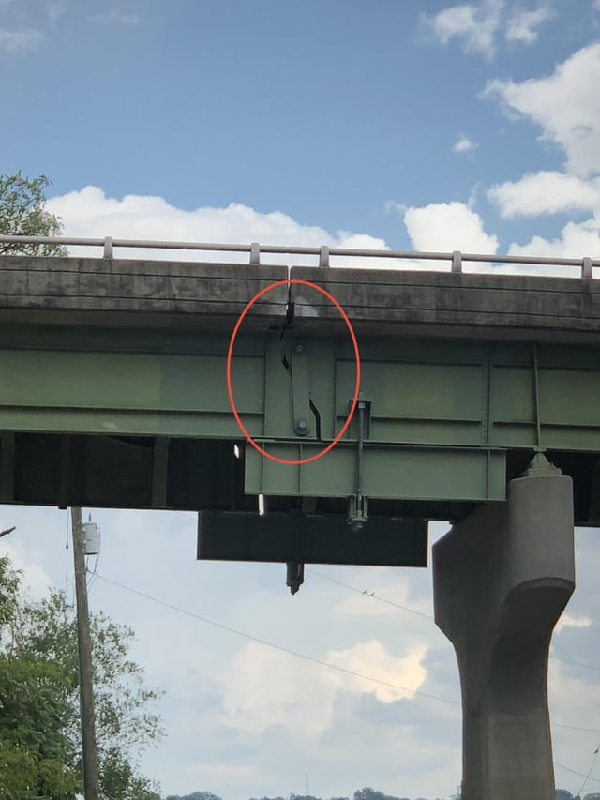

Slide 13
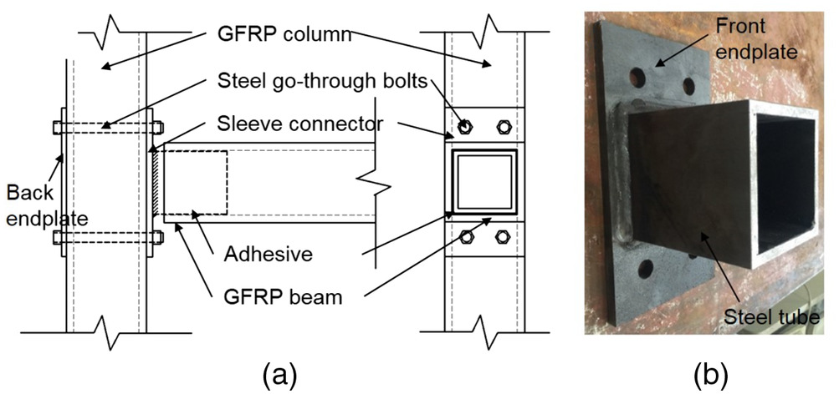

Slide 14
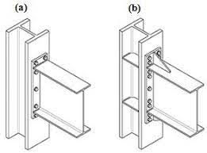
Rigid connection

Slide 15
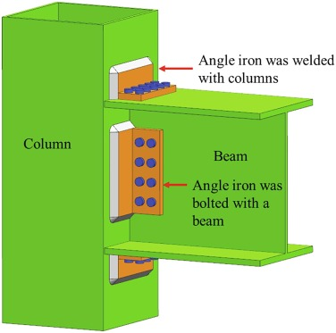
Rigid connection

Slide 16
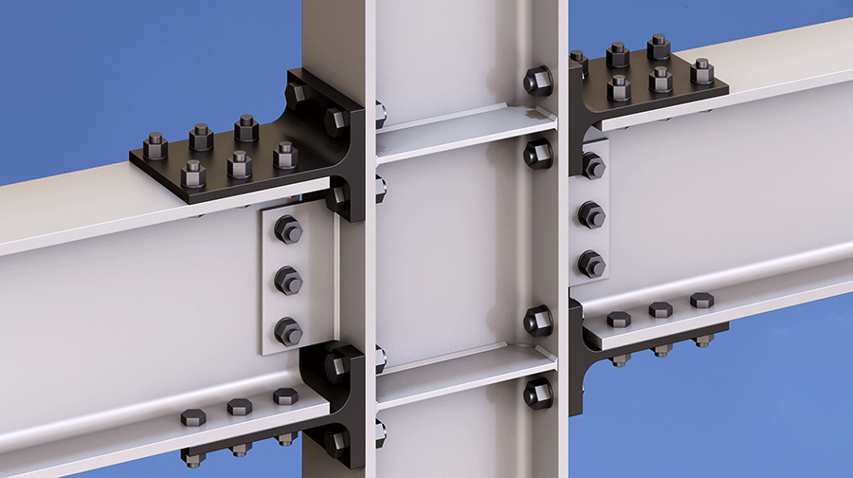
Rigid connection

Slide 17
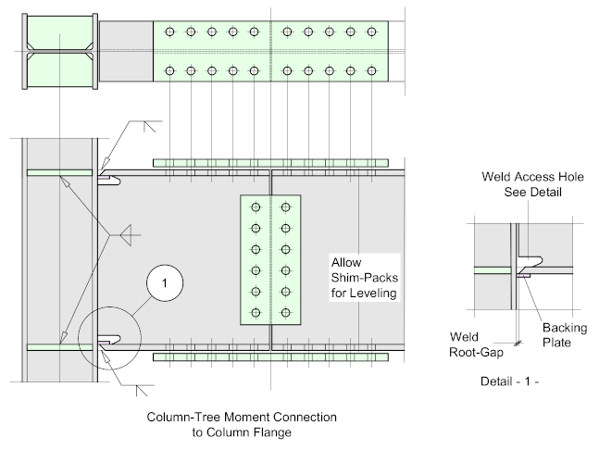
Rigid connection

